Slide 1
Project 2 – Image recognition with Convolutional Neural Networks
Group 4 –
Ben Paffrath
Jef Schroder Aubert
Karel de Rijk

Slide 2
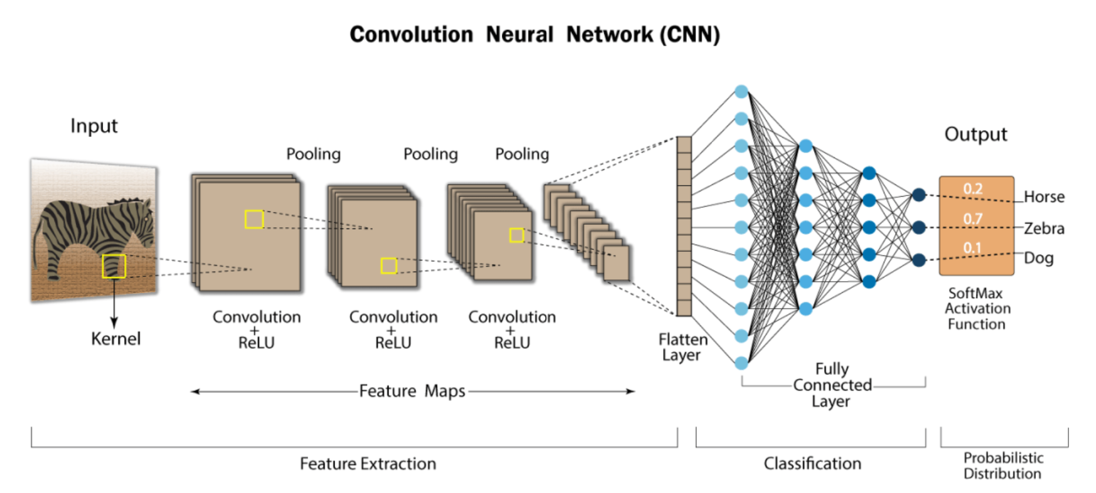
Executive overview
Objective: build a CNN model to classify images
Solution:
Built model from scratch (11 layers)
Accuracy score of 85%
Improved with transfer learning on DenseNet201
TL accuracy score: 93.91%

Slide 3
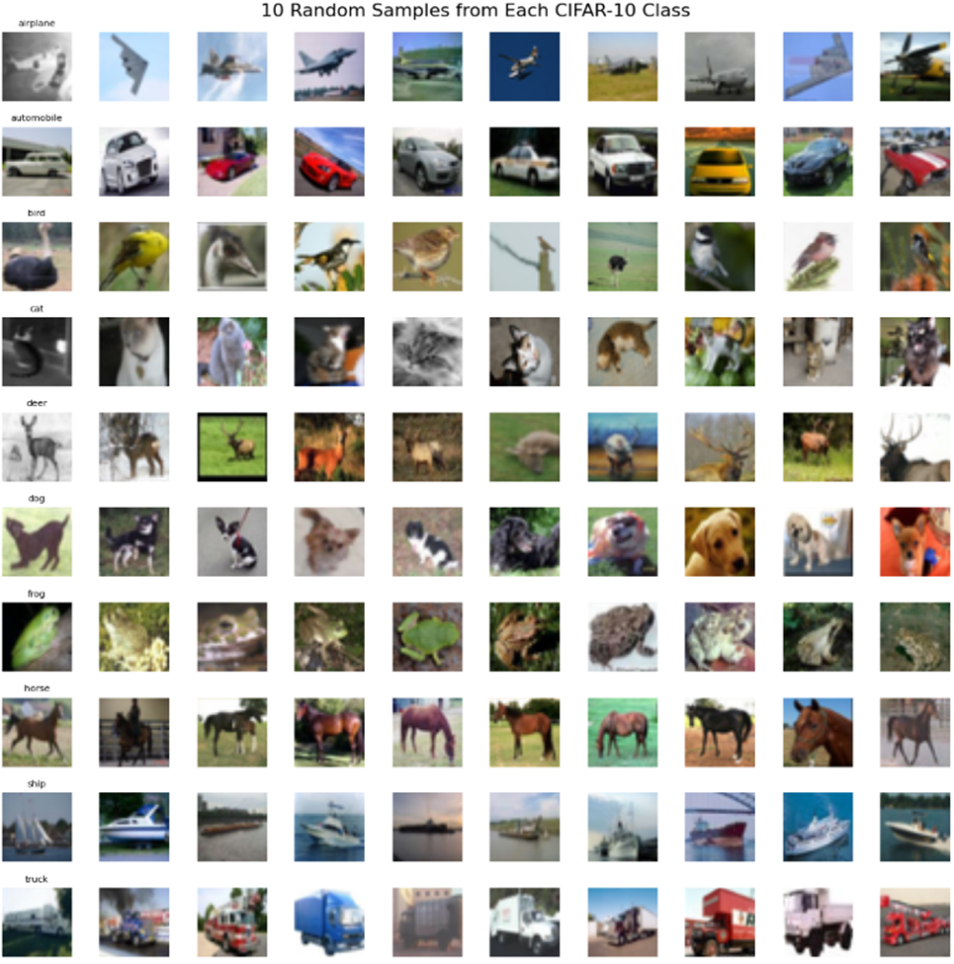
Chosen Dataset – CIFAR 10
Why CIFAR-10?
Largest dataset: 60,000 images
Already familiar
Balanced Classes: 6000 images per class

Slide 4
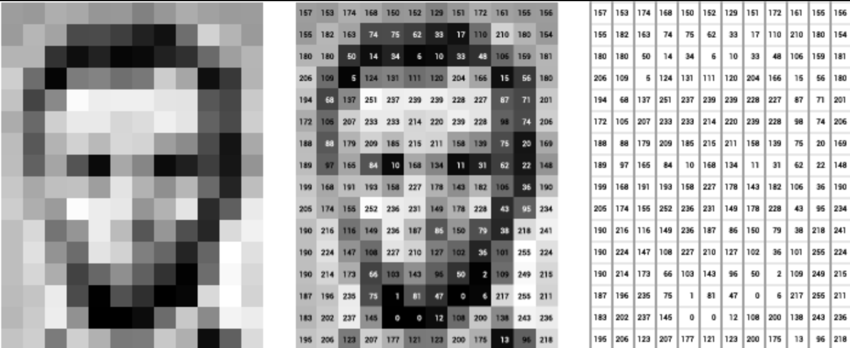
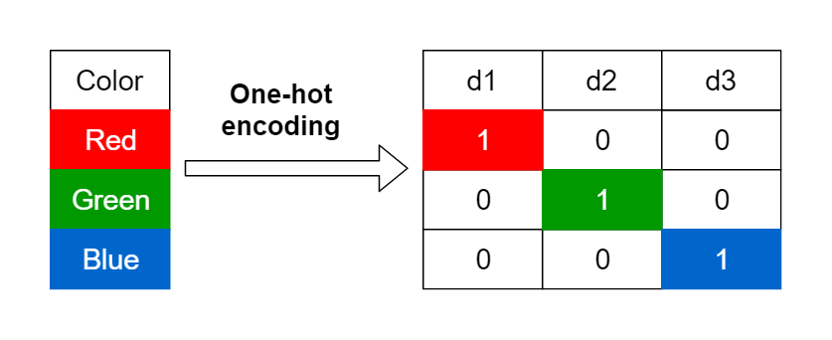
Data Preprocessing
Normalization
One-hot encoding

Slide 5
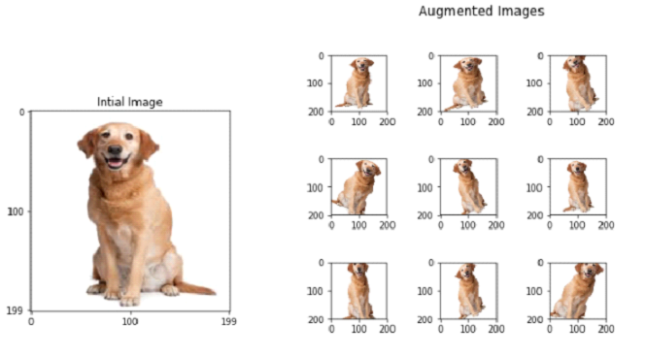
Data preprocessing - Augmentation

Slide 6
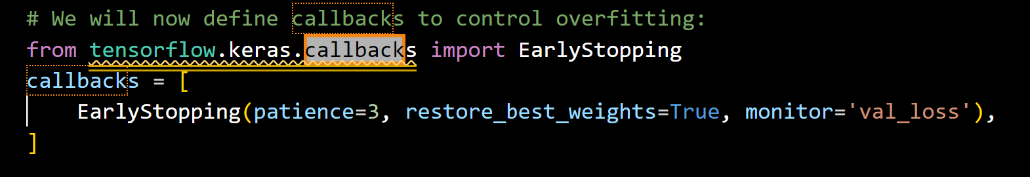
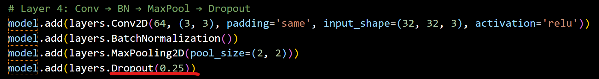
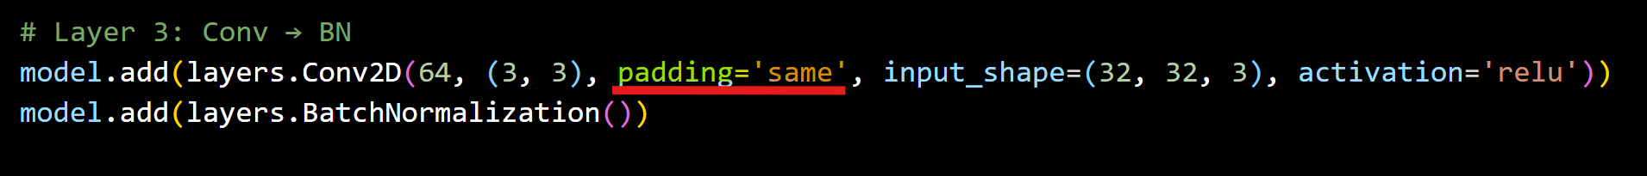
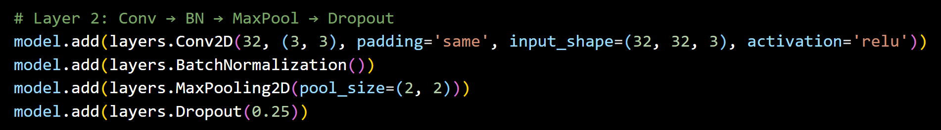
Optimization techniques
Early stopping
Stops training early when performance decreases.
Avoids overfitting
Dropout
Randomly drops out (sets to zero) a fraction of neurons during training
Implemented to avoid overfitting.
Padding
Keeps image output size equal between layers (layers able to learn rich features)
BatchNormalization
. Faster, more stable and efficient training. Minimize the impact of data drifting during training.

Slide 7
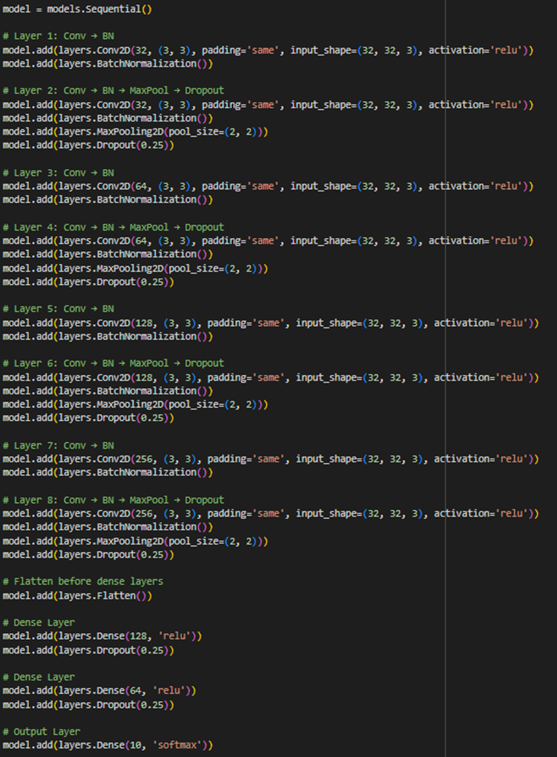
Designed CNN Architecture
Architecture
8 stacked convolutional blocks
Flattening
Concludes with 2 Dense and 1 output layer
Hyperparameters
Optimizer: Adam, LR: 0.0001
Loss Function: Categorical Crossentropy
Metrics: Accuracy
Batch Size: 32
Number of Epochs: 50
Early Stopping: 33

Slide 8
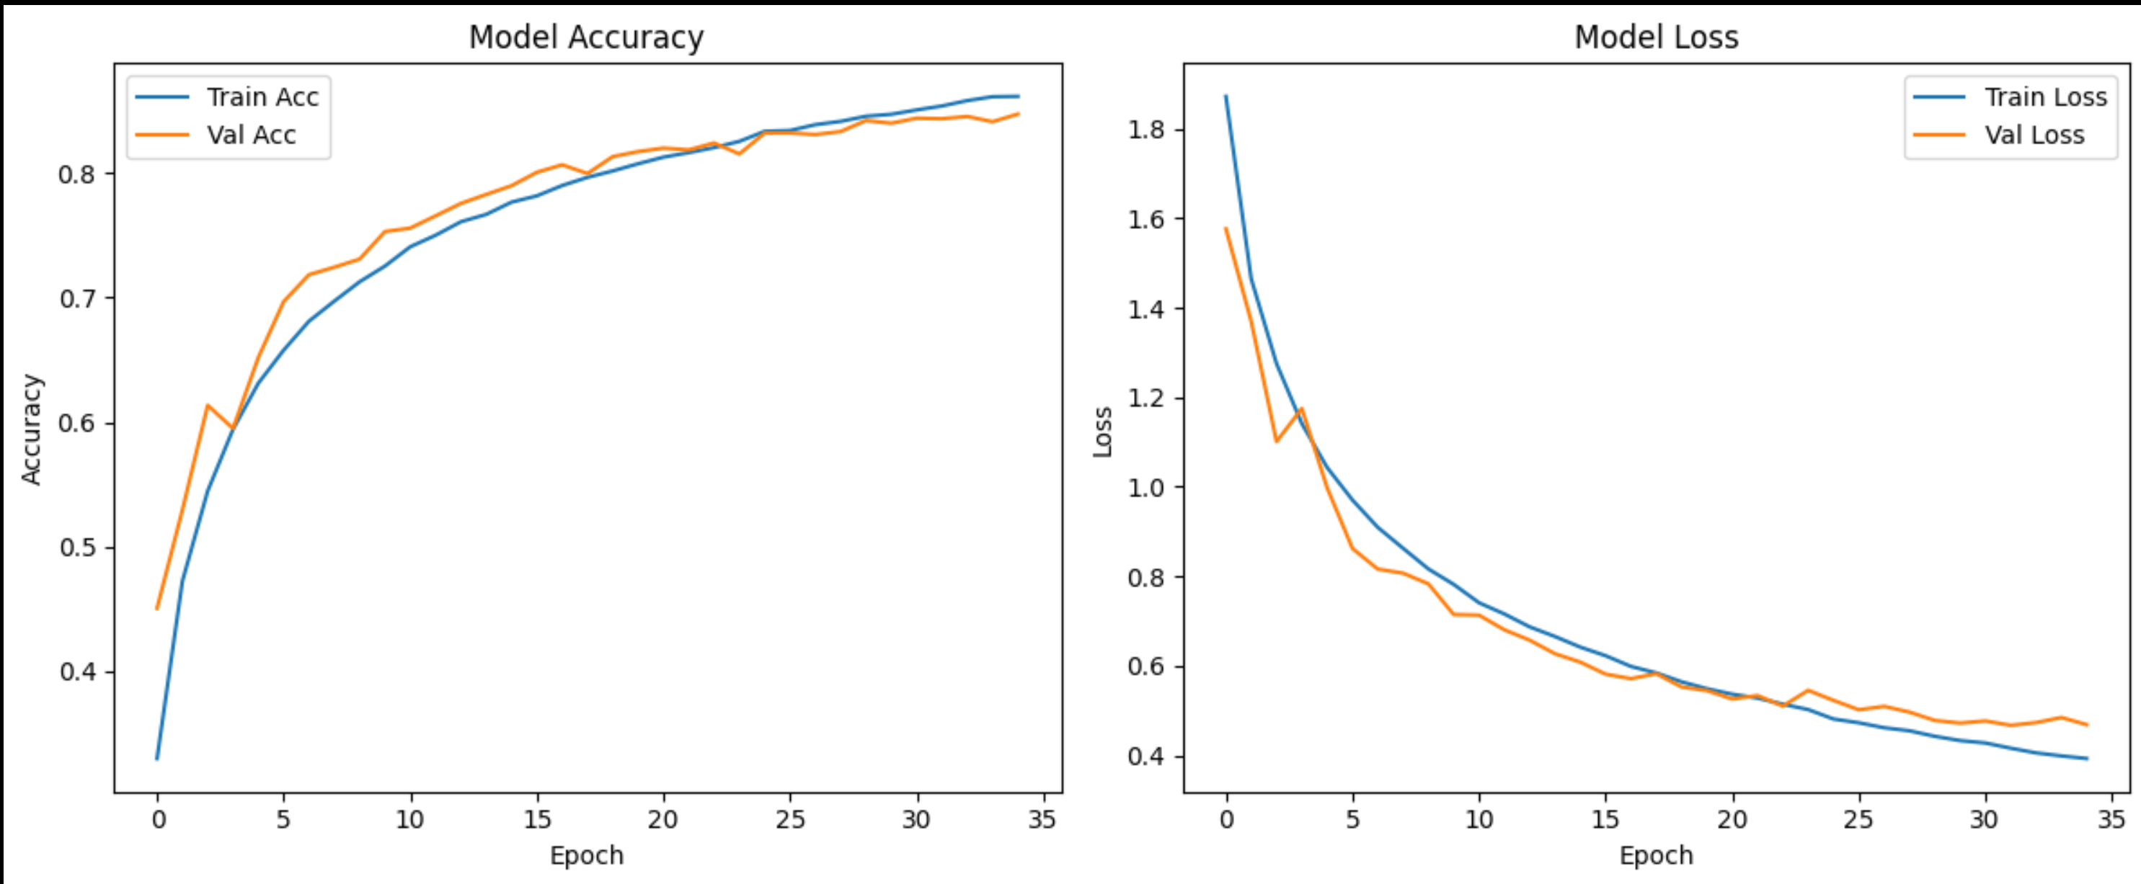
Designed CNN Architecture - progress
V0:
Two layers
Overfitting observed
Solution: implement Early Stopping
Version | Accuracy | Loss
V0 | 0.6418 | 2.5681
V1 | 0.7701 | 0.6817
V2 | 0.8214 | 0.5550
V3 | 0.8542 | 0.4475
V1:
Added 2 additional layers
Added Early Stopping and Dropout against overfitting
Reduced loss, increased accuracy
V2
Added 2 Convo layers per nr of filters
Early Stopping decreased from 10 to 5.
Improvements in accuracy and loss.
V3
Implemented Data Augmentation
Added 2 Convo layers with 256 filters each
Minimal overfitting

Slide 9
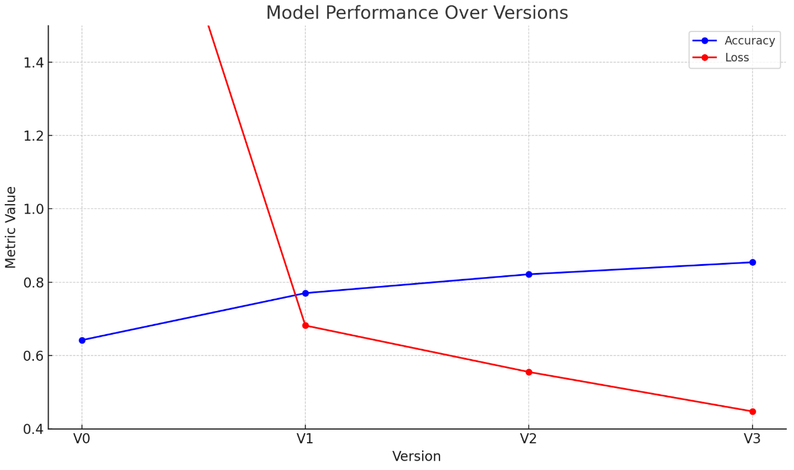
Draft slide Template

Slide 10
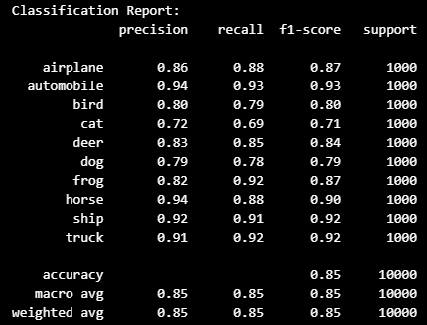

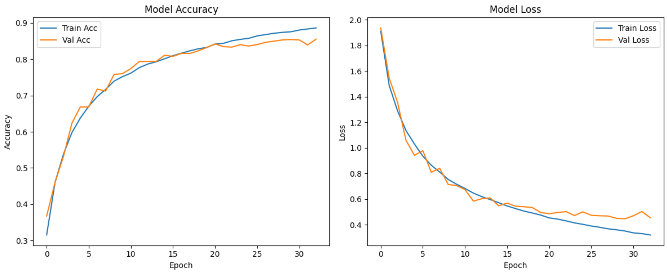
Evaluation – Accuracy and loss
Final accuracy score: 85%
Test Loss of 0.45
No significant signs of overfitting

Slide 11
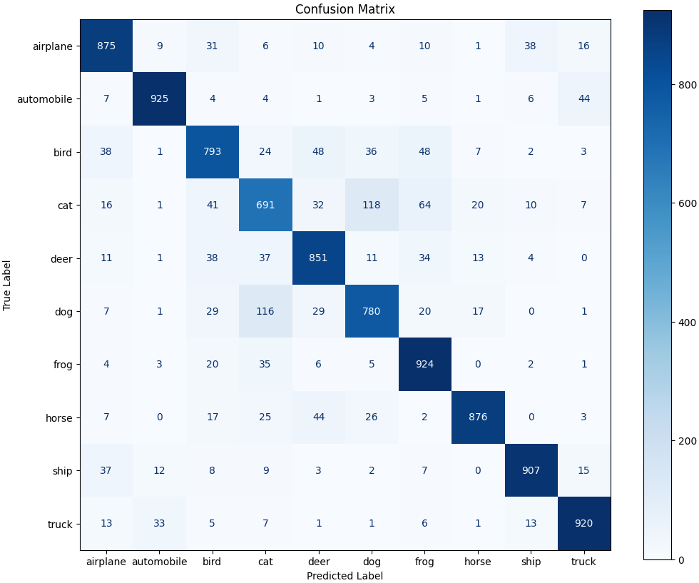
Evaluation – Confusion Matrix
High levels of accuracy:
- cars, horses, vessels
Most common confusions:
- Cats and dogs

Slide 12




Transfer Learning
DenseNet201
Deep and efficient architecture
VS
VGG16
Pre-trained in Imagenet
VS
ResNet
High performance on smaller datasets

Slide 13
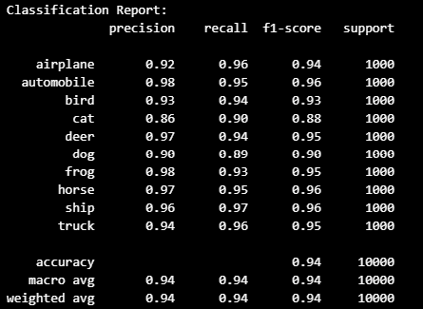
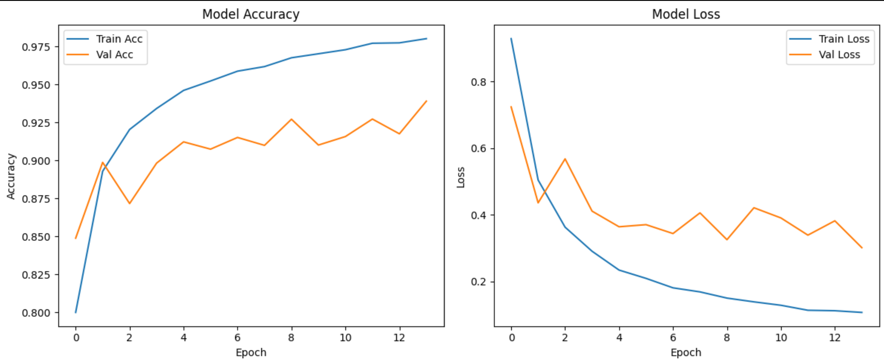
Transfer Learning - Evaluation
Final accuracy score: 93.91%
Test Loss of 0.30
No significant signs of overfitting

Slide 14
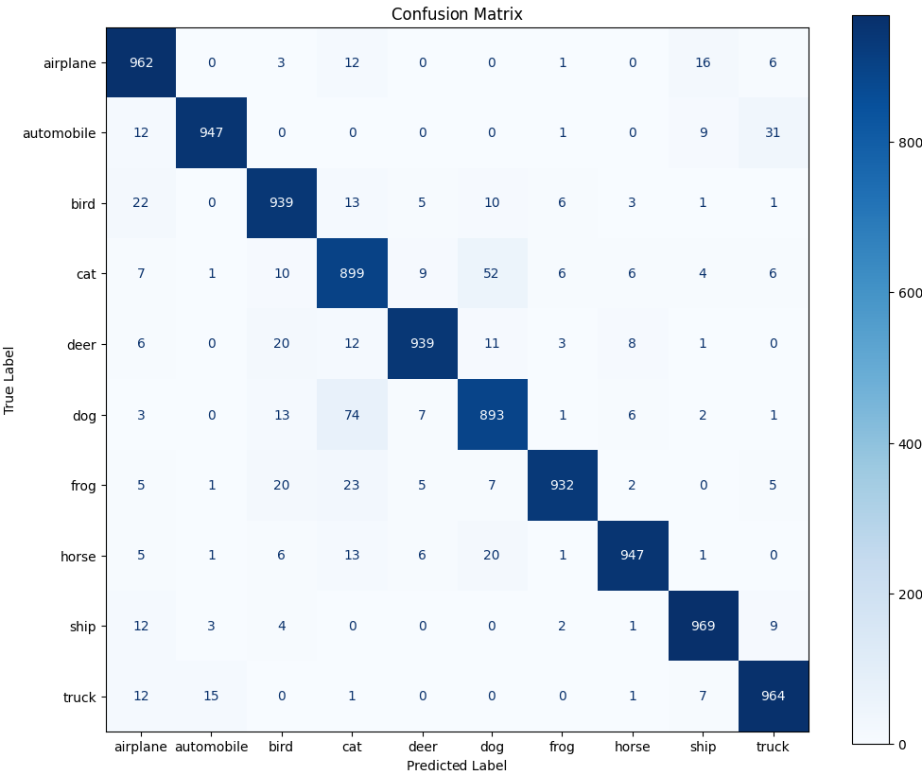
Transfer Learning – Confusion Matrix
Very high accuracy:
- cars, horses, vessels, planes
Most common confusions:
- Cats, dogs,

Slide 15
Deployment
https://ironhack-project-2-g4.benpaffrath.de/

Slide 16
Closing - Recap
Thoughts:
Iteratively improving with different parameters strongly impacted base model
Transfer learning
Useful for common use-cases such as image classification
Lower layers useful for feature extraction
Tradeoffs:
Overfitting vs accuracy
Training time vs accuracy

Slide 17
Thank You!
Group 4 –
Ben Paffrath
Jef Schroder Aubert
Karel de Rijk

